Slide 1



Resume Project Challenge
F & B DOMAIN
Code - X
Challenge -Provide Insights to the Marketing Team In Food & Beverage Industry.
FUNCTION MARKETING
Presenter - Harsh Pimpalkar
Notes:
Hello, everyone! I'm Harsh Pimpalkar, and I'm excited to present a challenging project today. Our goal is to provide valuable insights to Code X, a company in the food and beverages industry, to help their marketing team excel.
This project is part of the resume codebasics challenge, organized by codebasics itself. In this presentation, we will carefully analyze the available data, discuss the problem we're tackling, share our approach to solving it, and highlight the key findings we discovered.
So, let's get started on this enlightening journey where we uncover hidden opportunities and unlock the potential in food and beverages marketing for Code X.

Slide 2

F & B DOMAIN
Agenda
About
Background
Objectives
Data Schema & Data Structure
Insights
Recommendation
02
FUNCTION MARKETING

Slide 3
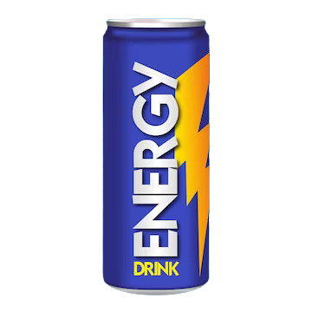
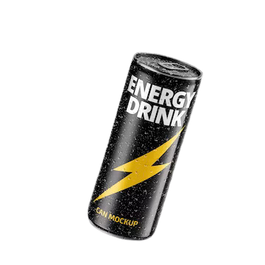
F & B DOMAIN
About - CodeX
03
CodeX is a German beverage company that is aiming to make its mark in the Indian market.
FUNCTION MARKETING

Slide 4
F & B DOMAIN
Background
A few months ago, Codex successfully launched its energy drink in ten cities across India.
Following the product launch, the marketing team at Codex conducted a comprehensive survey across these ten cities, gathering valuable insights from a total of 10,000 respondents.
Now, the marketing team is focused on analyzing the survey responses to drive brand awareness, expand market share, and enhance product development strategies.
04
FUNCTION MARKETING

Slide 5


F & B DOMAIN
Delhi
Jaipur
Lucknow
Gujrat
10 Metro City
Where Code X Launched their Energy Drinks
Mumbai
Kolkata
Pune
05
Hyderabad
Bangalore
FUNCTION MARKETING
Chennai

Slide 6
05
Marketing objectives
F & B DOMAIN
Objective 1
Objective 2
Objective 3
FUNCTION MARKETING
How can we effectively increase brand awareness for Codex's energy drink?
What strategies should be implemented to expand Codex's market share?
How can we enhance product development for Codex's energy drink to meet consumer demands and preferences?

Slide 7
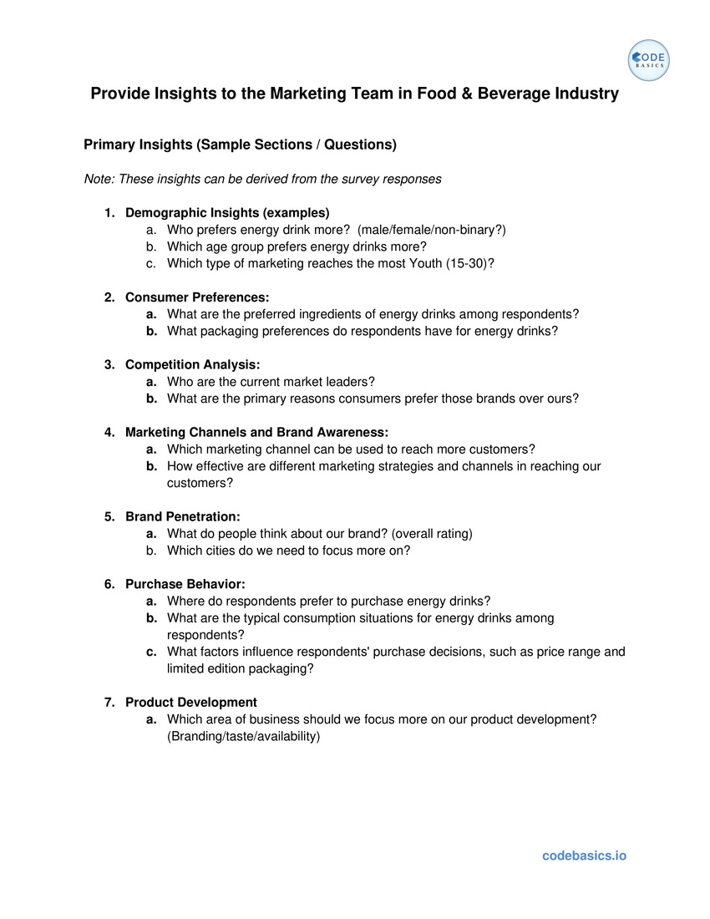
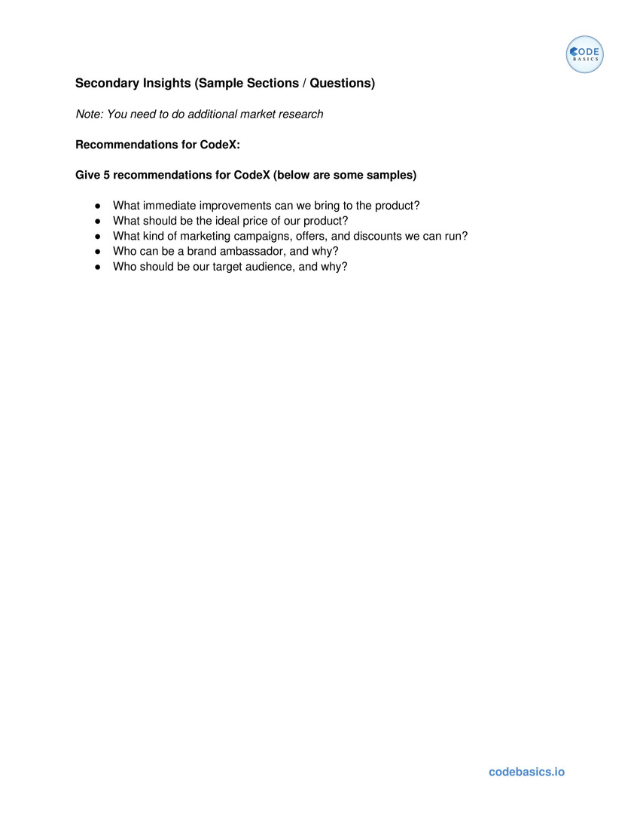



F & B DOMAIN
Insights
07
Tools
Insights
FUNCTION MARKETING
Notes:
Throughout the project, we have to address various types of insights and answere questions. To accomplish this, we utilized two powerful tools: MySQL and Power BI.

Slide 8
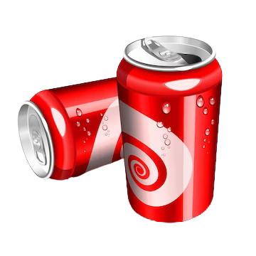
F & B DOMAIN
Introduction to Energy Drinks
An energy drink is a beverage designed to provide a boost of energy and increased mental alertness. It typically contains ingredients such as caffeine, vitamins, and herbal supplements. Energy drinks are popular among people looking for a quick pick-me-up, whether they need to stay awake, improve performance, or increase focus. While they can provide a temporary energy boost, it's important to consume them in moderation and be aware of their potential side effects due to the high caffeine content.
08
FUNCTION MARKETING
Notes:
Energy drinks are beverages formulated to enhance energy levels and mental alertness, commonly consumed for a quick energy boost. They contain caffeine, vitamins, and herbal supplements, but should be consumed in moderation due to potential side effects from their high caffeine content.

Slide 9
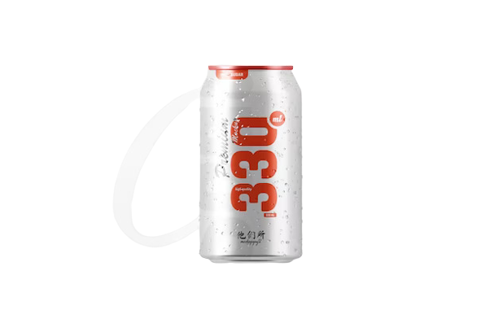
9.98%
F & B DOMAIN
India Energy Drinks Market
The Indian energy drink market is projected to register a CAGR of 9.98% over the next five years.
Energy drinks are gaining massive popularity among millennials due to aggressive marketing campaigns targeting young consumers. Moreover, advertisements promote energy drinks as drinks that ignite the mind, refresh the body, and enhance performance and stamina.
Increased urbanization, rising disposable income, and growing health consciousness among the Indian youth have increased the demand for non-carbonated drinks called energy drinks. At the same time, long and erratic working hours and the increasing occurrence of social gatherings are driving Indian consumers toward consuming energy drinks, which are primarily classified as non-alcoholic, caffeinated, and sports drinks.
Quality is not to be compromised, so companies are pricing the products low but promising quality to gain a significant market share. Red Bull is the giant dominating this market and continues its run as the leader.
FUNCTION MARKETING
Notes:
The Indian energy drink market is projected to grow at a CAGR of 9.98% over the next five years. Energy drinks are gaining popularity among millennials, driven by aggressive marketing and perceived benefits for mind and body. Factors such as urbanization, rising disposable income, and increased health consciousness contribute to the demand for non-carbonated energy drinks. Companies focus on competitive pricing while maintaining product quality. Red Bull remains the dominant player in the market.

Slide 10
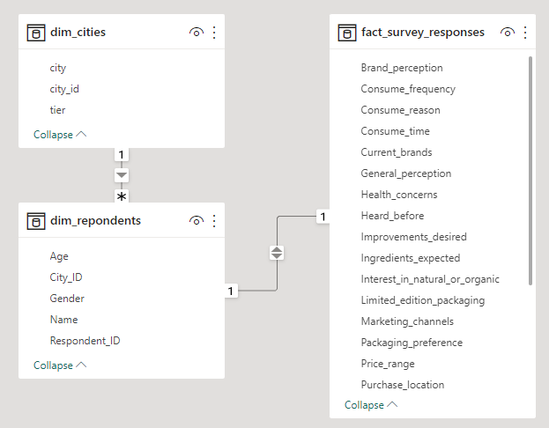
Data Structure
Data Schema (ERD)
F & B DOMAIN
Cities Were codex launched energy drink
dim_cities
dim_respondents
Respondents Details
fact_survey_response
Survey details
FUNCTION MARKETING
Notes:
To generate meaningful insights we used sql lang.

Slide 11

F & B DOMAIN
Insights
Demographics Insights
Consumer Preferences
Competition Analysis
Marketing Channels - Brand Awareness
Brand Penetration
FUNCTION MARKETING
Purchase Behaviour
Product Development

Slide 12
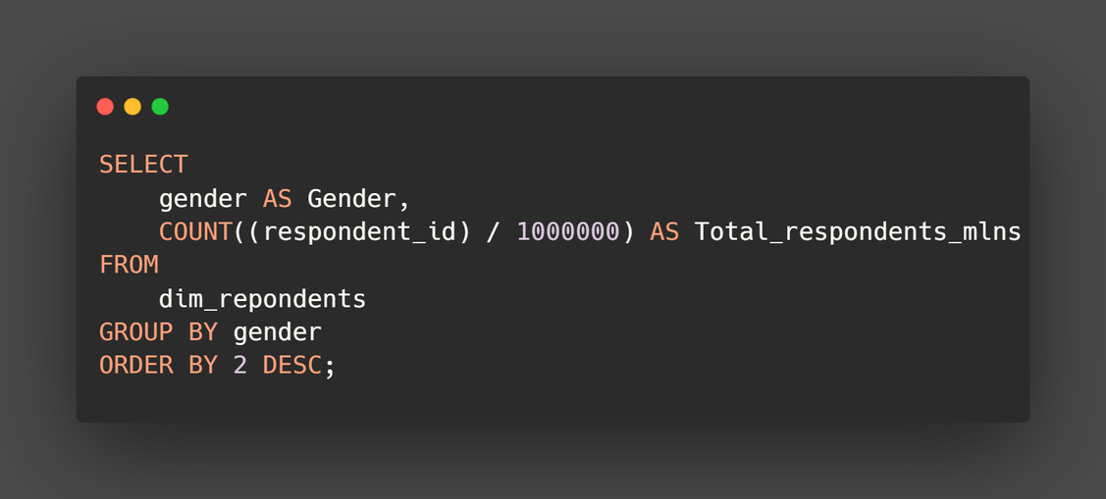
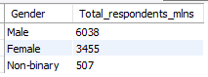
Demographic Insight
F & B DOMAIN
Who prefers energy drinks more? (male/female/non-binary?)
Non-Binary
5.1%
Female
34.6%
12
Male
60.4%
FUNCTION MARKETING
Energy drinks are primarily favored by the male population, constituting approximately 60% of its enthusiasts, while females and the non-binary population follow suit in their level of interest.
Notes:
Energy drinks have a higher popularity among males, followed by females and the non-binary population.

Slide 13
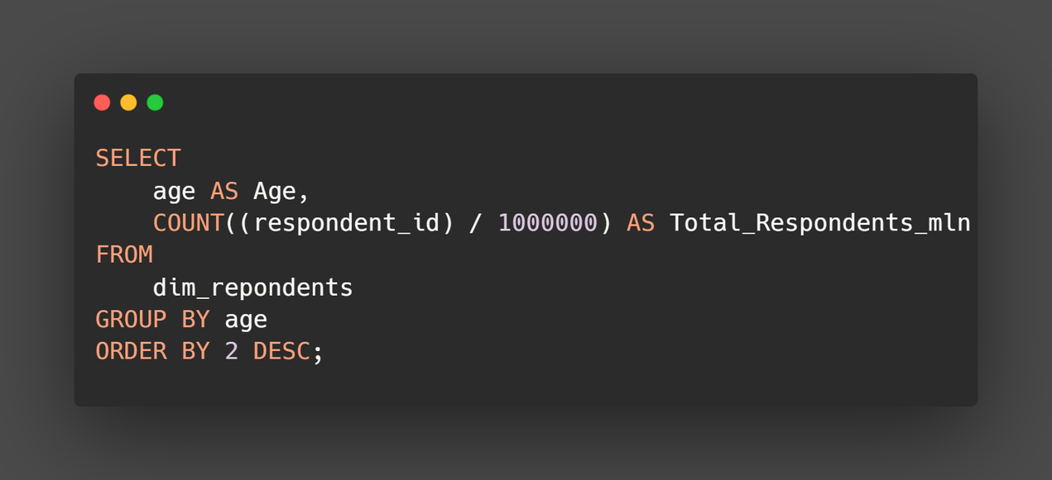
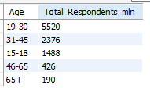
Demographic Insight
F & B DOMAIN
Which age group prefers energy drinks more?
6,000
4,000
2,000
FUNCTION MARKETING
0
The age group of "19-45" exhibits the highest concentration of consumers for energy drinks, making it an essential target segment for effective marketing strategies.
15-18
19-30
31-45
45-65
65+
Notes:
Targeting the age group of 19-45 is crucial, as they constitute the largest consumer segment of energy drinks.

Slide 14
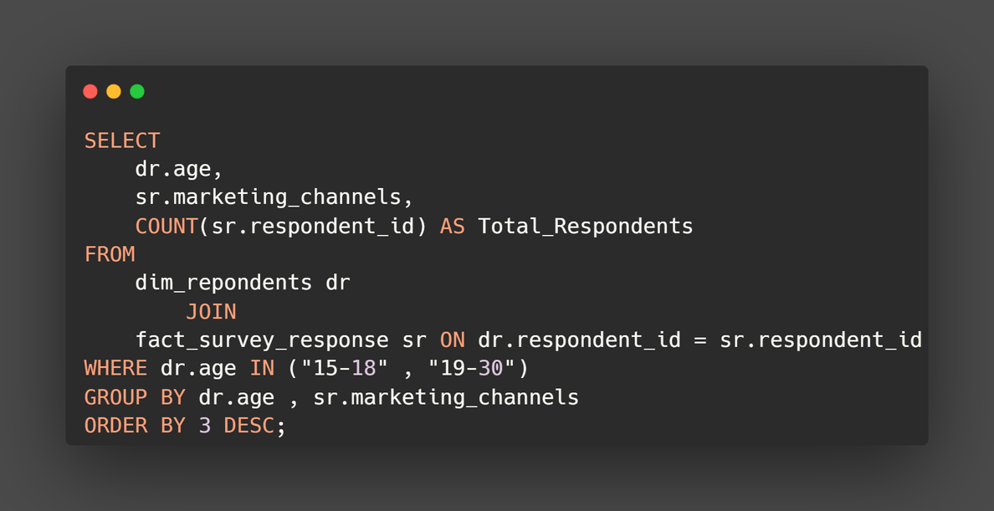
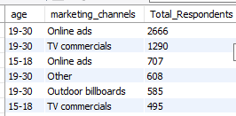
Demographic Insight
Which type of marketing reaches the most Youth (15-30)?
F & B DOMAIN
4,000
3,000
2,000
12
1,000
0
FUNCTION MARKETING
Online-Ads
TV Commercials
"Online advertising and TV commercials have emerged as the most popular and highly effective channels for engaging with young customers."
Notes:
Online advertising is the most effective channel to engage with young customers in the energy drink market.

Slide 15
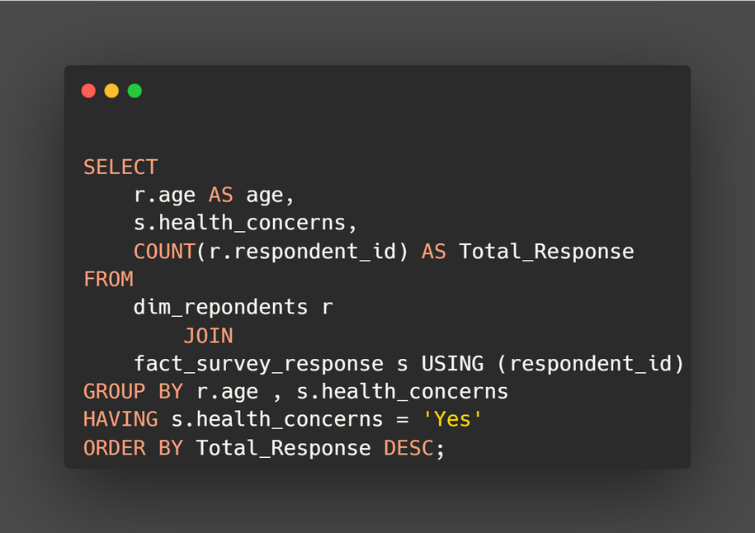
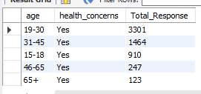
Demographic Insight
Which age group is the most health-conscious when it comes to energy drinks?
F & B DOMAIN
4,000
3,000
2,000
1,000
FUNCTION MARKETING
0
15-18
19-30
31-45
45-65
65+
"The age group of 19-30 demonstrates a greater inclination towards health concerns when it comes to energy drinks, in comparison to other age groups."
Notes:
The age group of 19-30 shows a stronger inclination towards health concerns regarding energy drinks compared to other age groups.

Slide 16
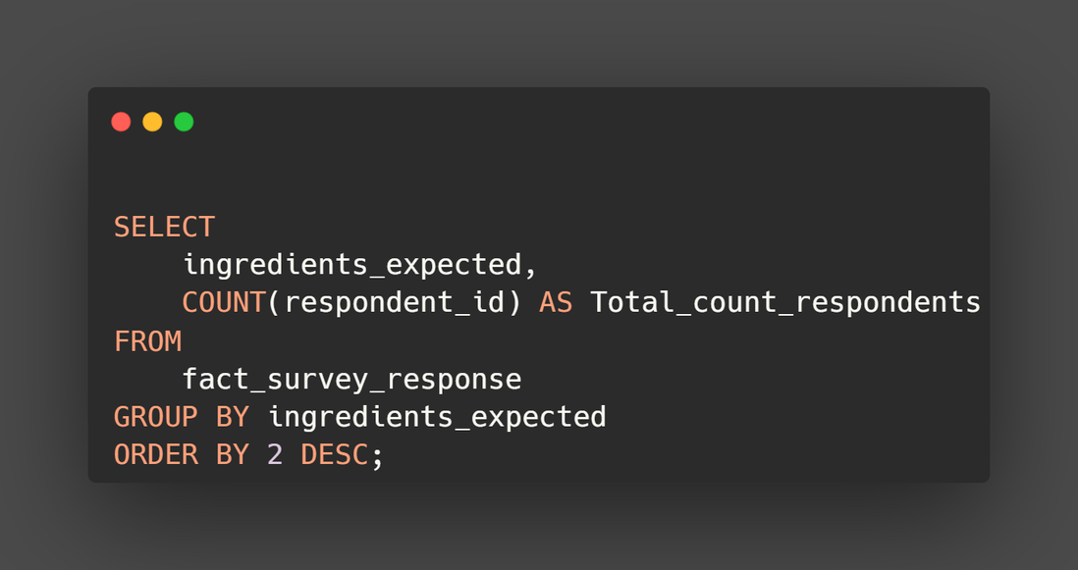
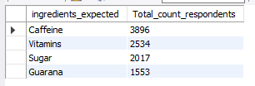
Consumer Preferneces
What are the preferred ingredients of energy drinks among respondents?
F & B DOMAIN
Guarana
15.5%
Caffeine
39%
Sugar
20.2%
16
FUNCTION MARKETING
Vitamins
25.3%
"Caffeine emerges as the most preferred ingredient among all genders, with vitamins, sugar, and Guarana following suit."
Notes:
Among all genders, caffeine is the most preferred ingredient in energy drinks, followed by vitamins, sugar, and Guarana.
caffine is widely recongized for its stimulating effects. providing a boost of energy and alertness.
vitamins in every drinks appeals to handle consicous conusumers.

Slide 17
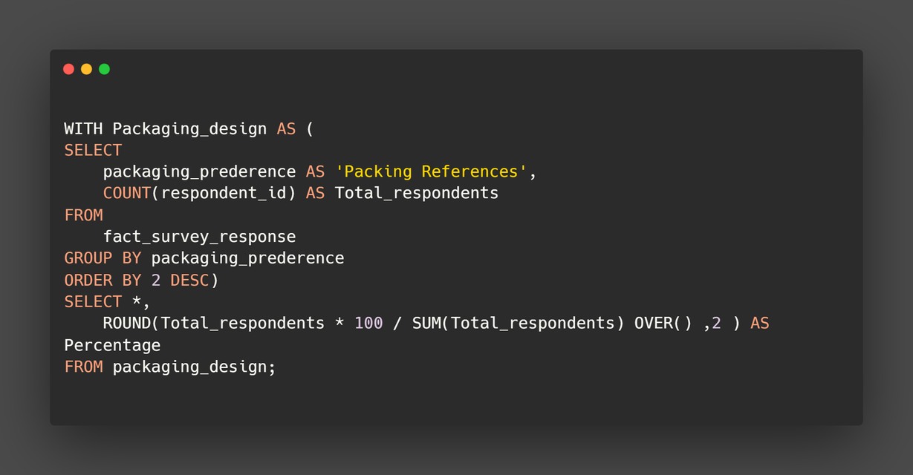
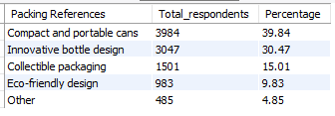
Consumer Preferneces
What packaging preferences do respondents have for energy drinks?
F & B DOMAIN
Other
4.8%
Eco-Friendly
9.8%
Cans
39.8%
Collectible
15%
17
Bottle
30.5%
FUNCTION MARKETING
"Cans and bottles emerge as the preferred choices for packaging among consumers, owing to their convenience in terms of portability and aesthetic appeal. Not only are they easy to carry, but they also provide a stylish and visually appealing look when held."
Notes:
Cans and PET bottles are the preferred packaging choices for energy drinks due to their portability and aesthetic appeal.

Slide 18
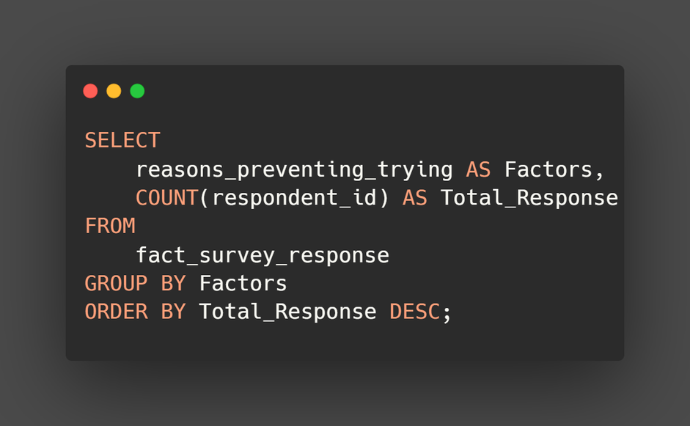
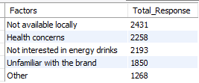
Consumer Preferneces
What are the key factors influencing consumers decision to try new energy drinks brands?
F & B DOMAIN
Not Available Locally
Health Concern
Not Interested
Unfamiliar
Other
FUNCTION MARKETING
The key factors influencing consumers' decisions to try new energy drink brands are the unavailability of the brand locally, with 2,431 respondents indicating this as a significant factor, followed closely by health concerns, identified by 2,258 respondents.
0
500
1,000
1,500
2,000
2,500
Notes:
The unavailability of the brand locally is identified as the primary factor influencing consumers' decisions to try new energy drink brands.

Slide 19
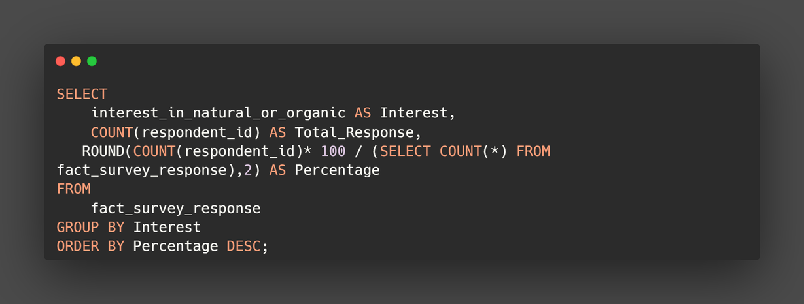
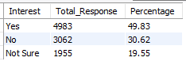
Consumer Preferneces
Are Consumers willing to pay a premium for energy drinks with natural or organic ingredients?
F & B DOMAIN
Not Sure
19.6%
Yes
49.8%
19
No
30.6%
FUNCTION MARKETING
A significant portion of consumers, approximately 49.83%, express willingness to pay a premium for energy drinks that contain natural or organic ingredients, while 30.62% of respondents indicate otherwise.

Slide 20
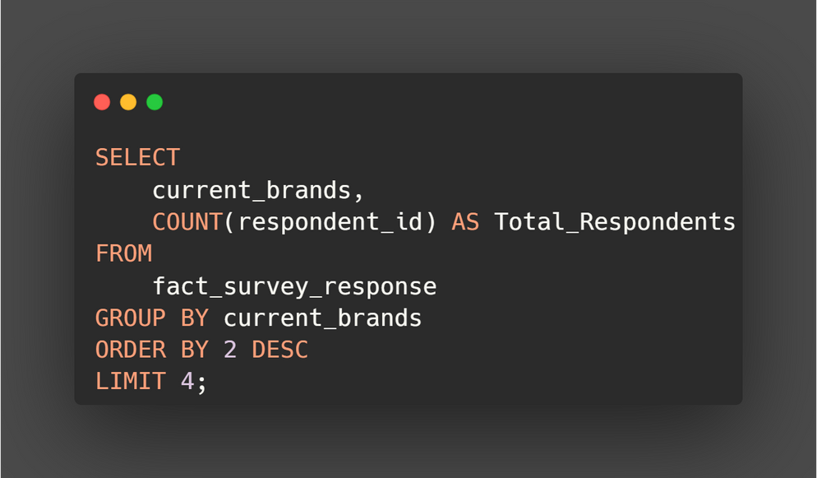
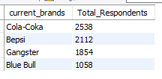
Competition Analysis
Who are the current market leaders?
F & B DOMAIN
3,000
2,000
1,000
FUNCTION MARKETING
0
Cola-Coka
Bepsi
Gangster
Blue Bull
Cola-Coka, Bepsi, and Gangsters currently dominate the energy drinks market as the leading brands.
Notes:
Cola-Coka, Bepsi, and Gangsters hold the market leadership positions in the energy drink industry.
TO compete effectively with theses energy drinks brands should focus on diferentiation and inovations

Slide 21
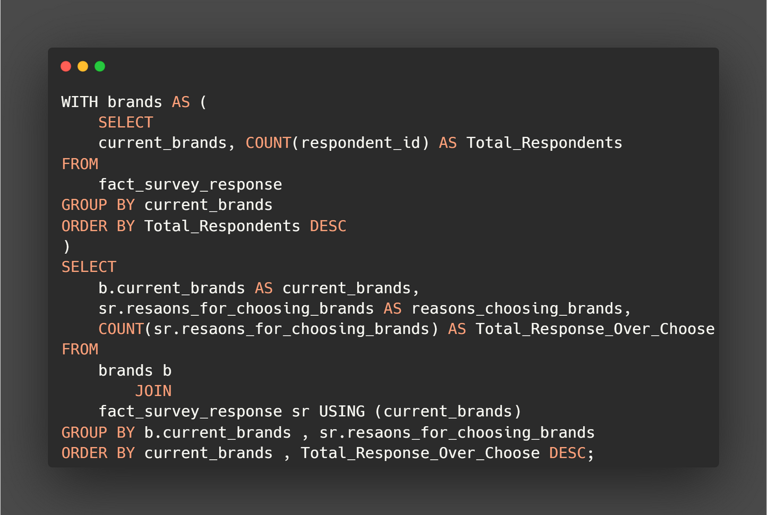
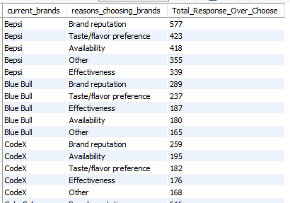
Competition Analysis
What are the primary reasons consumers prefer those brands over ours?
F & B DOMAIN
FUNCTION MARKETING

Slide 22
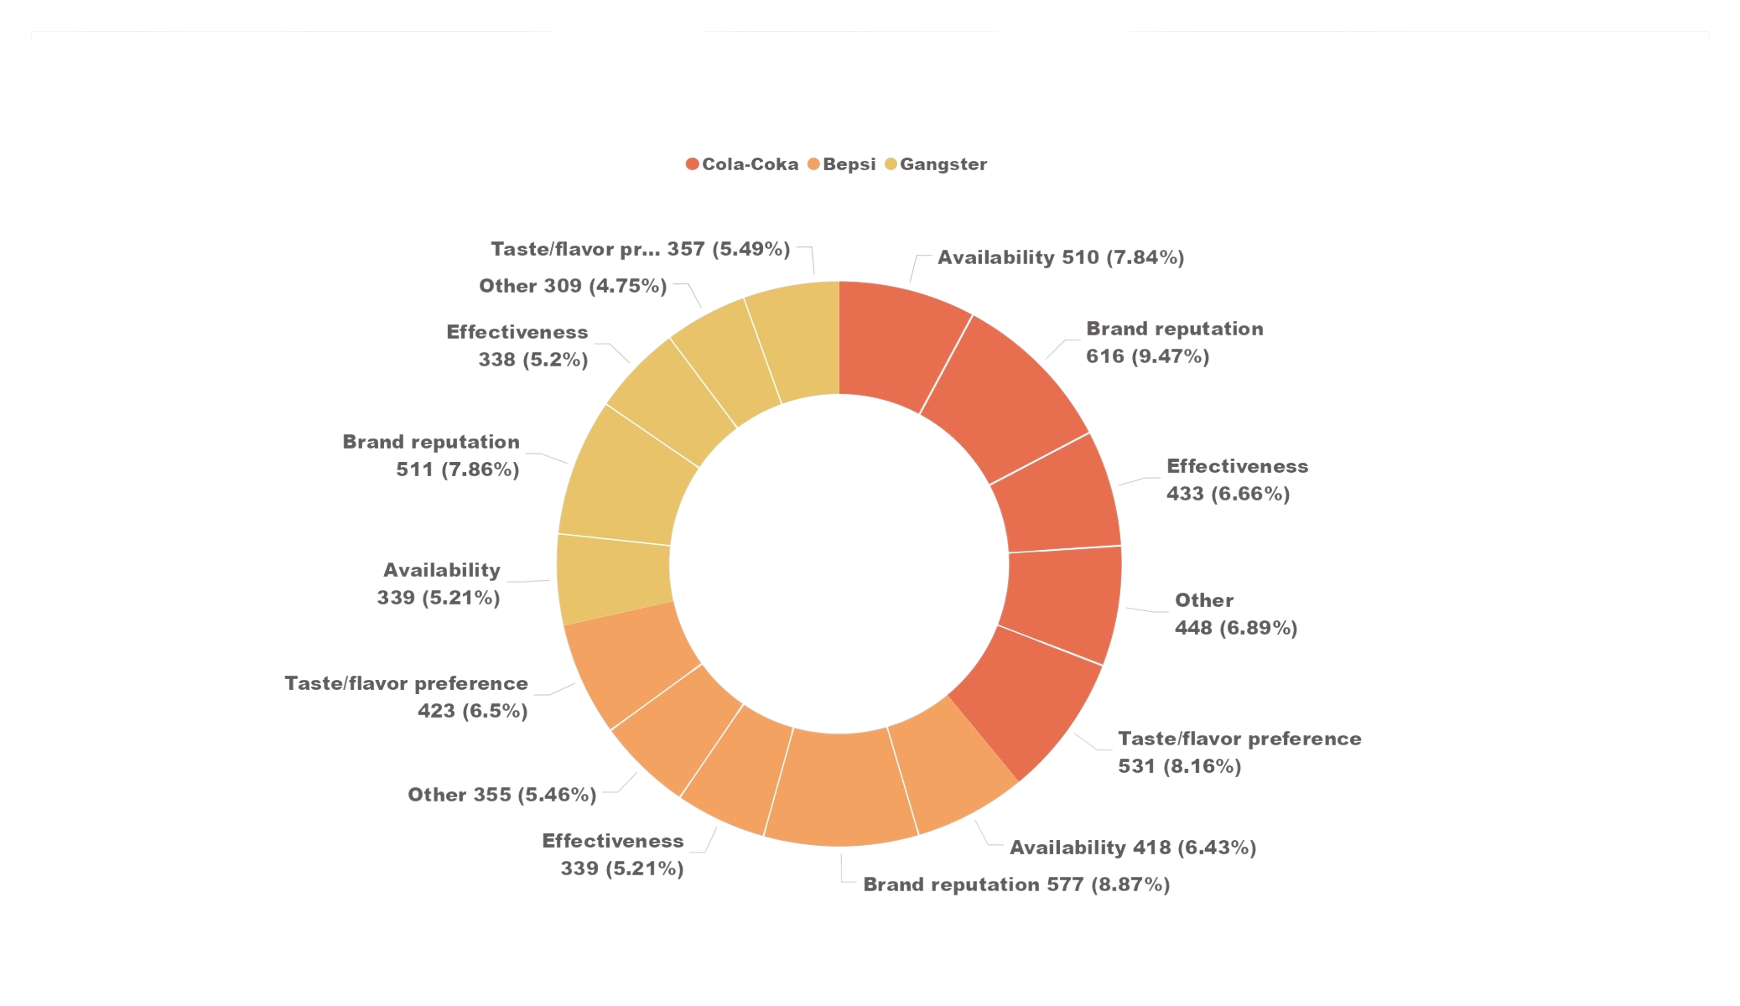
Competition Analysis
F & B DOMAIN
Brand reputation emerged as a significant factor across multiple brands, with respondents citing it as a reason for choosing brands
Availability played a role in the brand selection process, as respondents mentioned,
Understanding these preferences can help the CodeX brand tailor their marketing strategies to emphasize its strengths and address weaknesses. By focusing on brand reputation, taste/flavor preferences, availability, and effectiveness, brands can better position themselves to attract and retain customers.
22
FUNCTION MARKETING
Notes:
Brand reputation and availabiltu play an important role.
For the codex enerfy drink by focusing on brnad reputation, taste/falvour and avialbility and effectiveness can beter position
themsevles to attract and retain customers.

Slide 23
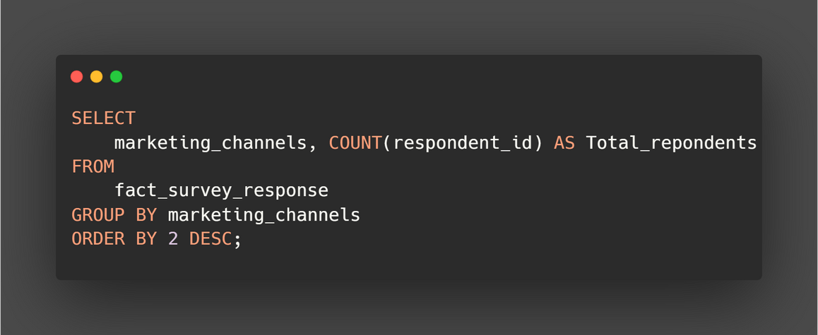
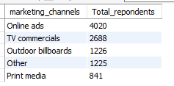
Marketing Channels and Brand Awareness
Which marketing channel can be used to reach more customers?
F & B DOMAIN
Billboards
15.5%
Online Ads
50.7%
23
TV-Commercial
33.9%
FUNCTION MARKETING
The online channel stands out as the most effective marketing strategy for promoting brands among youths.
Notes:
Online channels, TV commercials, and outdoor billboards are the most effective marketing channels for the given set of respondents.

Slide 24
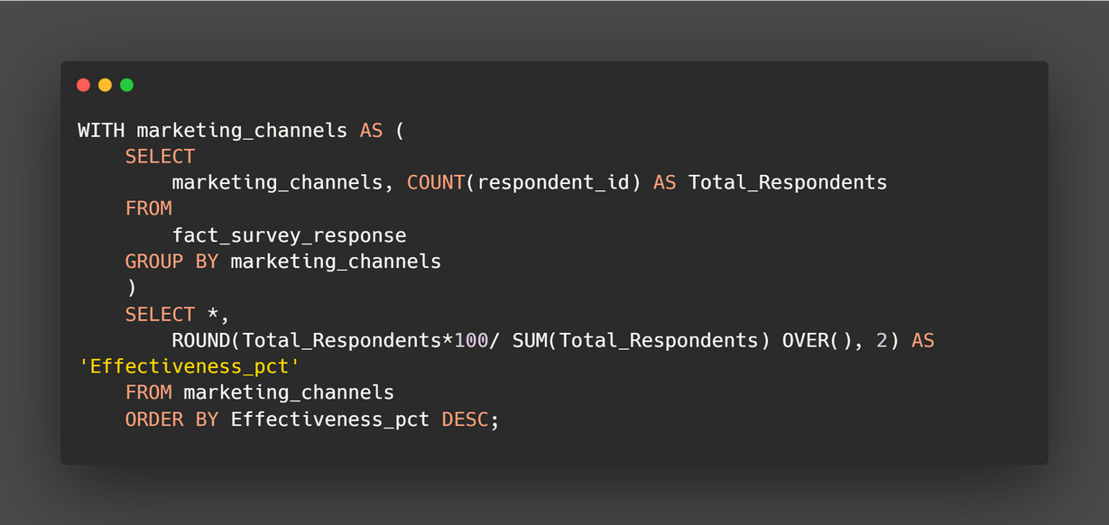
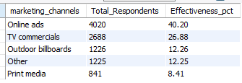
Marketing Channels and Brand Awareness
How effective are different marketing strategies and channels in reaching our customers?
F & B DOMAIN
Print-Media
8.4%
Other
12.3%
Online Ads
40.2%
Billboards
12.3%
TV-Commercial
26.9%
FUNCTION MARKETING
According to the given set of respondents, the online channel emerges as the most effective marketing channel, closely followed by TV commercials and Outdoor Billboards.
Notes:
The online channel is the most effective marketing channel for the given set of respondents, followed by TV commercials and Outdoor Billboards

Slide 25
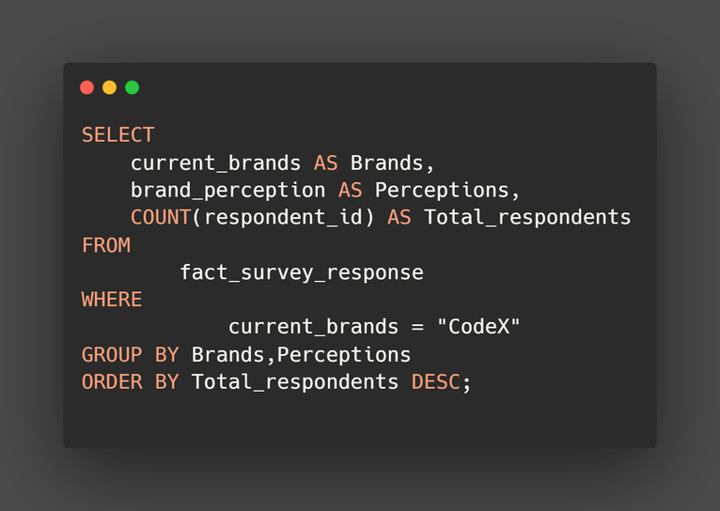
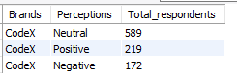
Brand Penetration
F & B DOMAIN
What do people think about our brand? (overall rating)
25
FUNCTION MARKETING
While most of the respondents provided neutral feedback about Codex, there is an opportunity for the company to implement effective marketing strategies that can convert these neutral respondents into positive and satisfied customers.
Notes:
Most of the respondents have neutral feedback about Codex. However, Codex can implement marketing strategies to convert respondents with neutral feedback into positive customers.

Slide 26
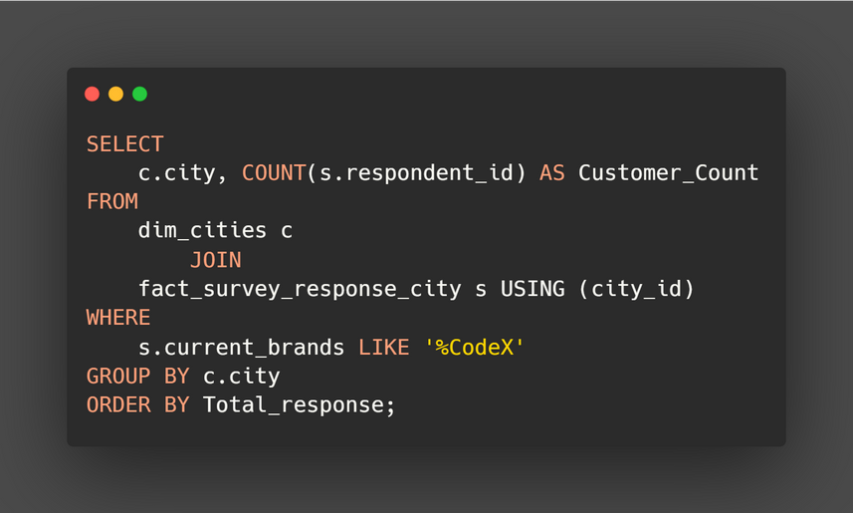
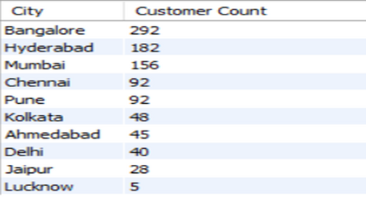
Brand Penetration
Which cities do we need to focus more on?
F & B DOMAIN
FUNCTION MARKETING
Bangalore emerges as the frontrunner with the highest number of respondents, followed by Hyderabad and Mumbai, indicating significant market potential. To capitalize on this opportunity, CodeX should prioritize and focus its efforts on Hyderabad and Mumbai to leverage the tremendous growth potential present in these cities.
Notes:
Bangalore leads in terms of respondent count, followed by Hyderabad and Mumbai, making them potential areas for growth.
CodeX should focus more on Hyderabad and Mumbai since they have tremendous potential for growth. Additionally, it would be beneficial to investigate the reasons behind Lucknow having the lowest number of respondents and work towards improving those numbers.

Slide 27
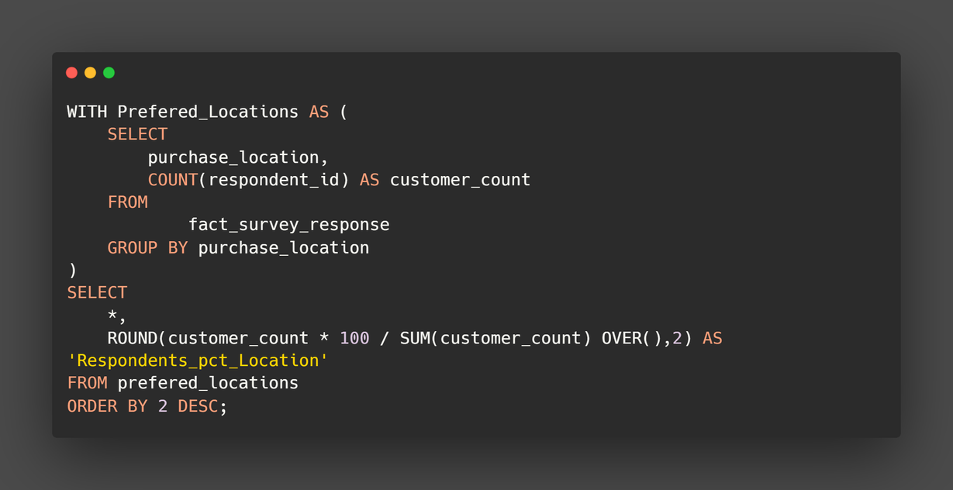
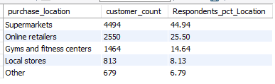
Purchase Behaviour
Where do respondents prefer to purchase energy drinks?
F & B DOMAIN
Fitness Centers
17.2%
Supermarkets
52.8%
27
Online Retailers
30%
FUNCTION MARKETING
When it comes to purchase location preference, it is evident that energy drink consumers have a strong inclination towards buying their energy drinks from supermarkets and online stores.
Notes:
Supermarkets and online stores are the preferred locations for energy drink purchases among consumers.

Slide 28
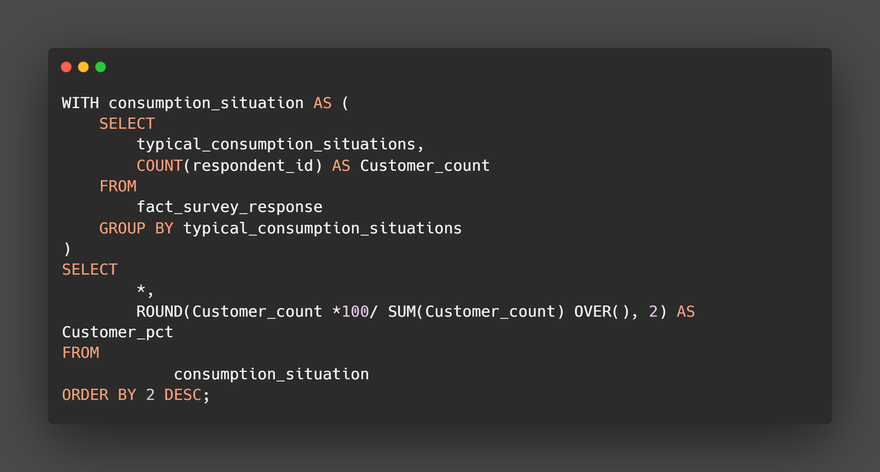
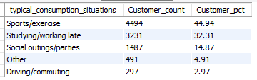
Purchase Behaviour
What are the typical consumption situations for energy drinks among respondents?
F & B DOMAIN
50
40
30
20
10
0
FUNCTION MARKETING
Sports/Exercise
Studying/Working Late
Social Outings/Parties
Energy drink consumption is most prevalent during sports/exercise, studying/working late, and social outings/parties, indicating that consumers associate these activities with the need for an energy boost.
Notes:
Energy drink consumption is most prevalent during sports/exercise, studying/working late, and social outings/parties, indicating that consumers associate these activities with the need for an energy boost.

Slide 29
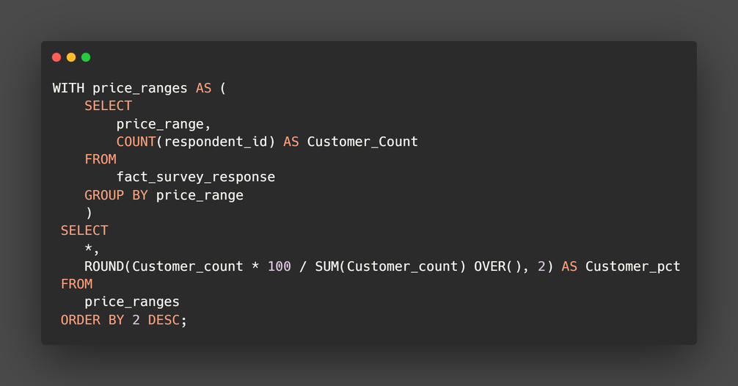
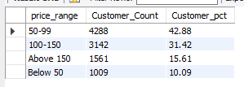
Purchase Behaviour
What factors influence respondents' purchase decisions, such as price range and limited edition packaging?
F & B DOMAIN
Price Range
Below 50
10.1%
Above 150
15.6%
50-99
42.9%
29
100-150
31.4%
FUNCTION MARKETING
The data shows an inverse relationship between the count of respondents and prices, indicating that as prices increase, the number of respondents decreases. However, it is noteworthy that the lowest total number of respondents is observed when the price range is below 50. On the other hand, the price range of 50-99 stands out with the highest number of customers.
Notes:
The number of respondents decreases as prices decrease, with the lowest count observed when the price range is below 50.
THE BEST PRICE IS 50-99.

Slide 30
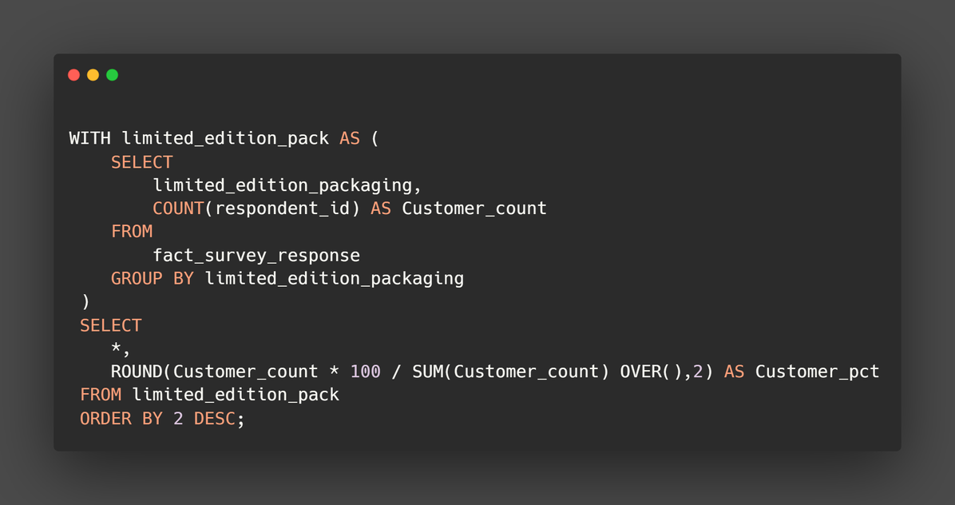
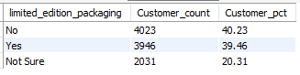
Purchase Behaviour
Limited edition Packaging
F & B DOMAIN
50
40
30
20
10
0
FUNCTION MARKETING
NO
YES
NOT_SURE
The data reveals that respondents' opinions on the limited edition packaging are fairly divided, with 40.23% responding negatively, 39.46% responding positively, and 20.31% remaining unsure. This suggests that the reception towards the limited edition packaging is mixed, indicating the need for further evaluation and analysis to determine the overall impact and effectiveness of the packaging strategy.

Slide 31
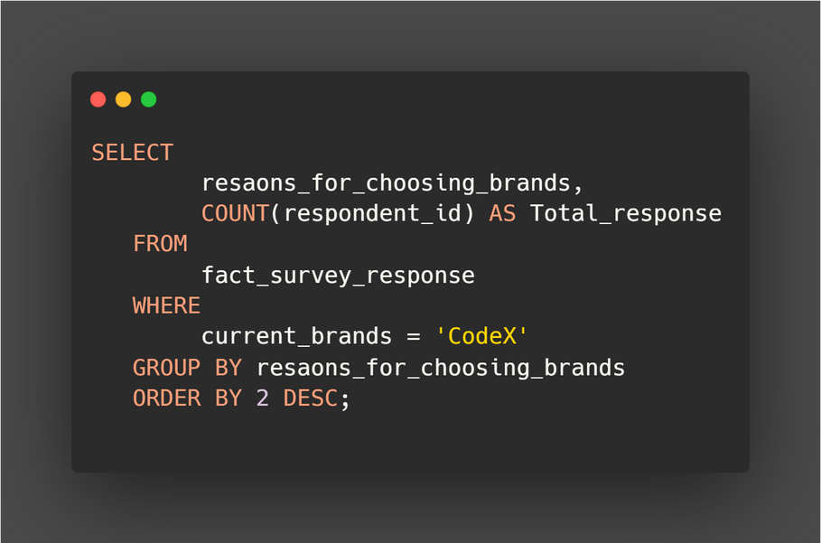
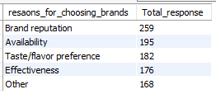
Product Development
Which area of business should we focus more on our product development? (Branding/taste/availability)
F & B DOMAIN
Reasons For Choosing Brands
Taste/Flavour preferences
28.4%
Brand-Reputation
40.9%
30
Availability
30.8%
FUNCTION MARKETING
Brand reputation and product availability are identified as the two primary factors that significantly attract a customer base.
Notes:
Brand reputation and product availability are the key factors that attract customers to energy drink brands.

Slide 32
F & B DOMAIN
Recommendations
FUNCTION MARKETING

Slide 33
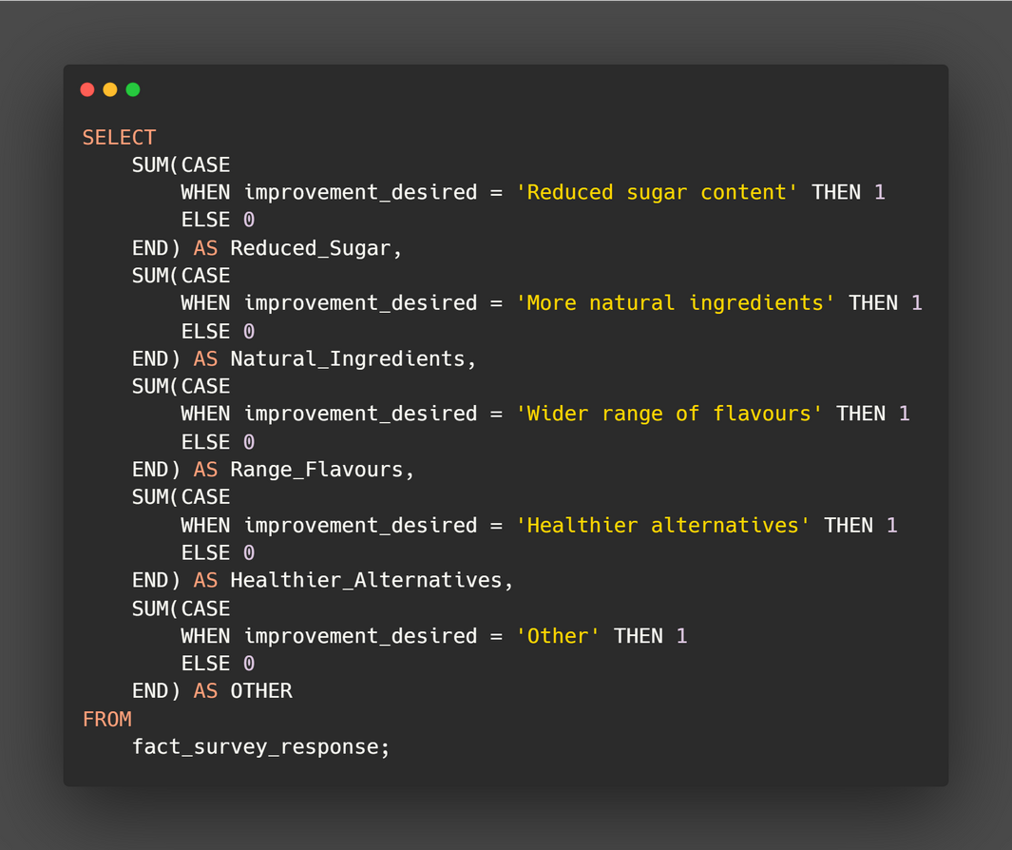
What immediate improvements can we bring to the product?
F & B DOMAIN
Healthier
21.1%
Reduced Sugar
43%
33
Natural Ingreidents
35.9%
consumers are increasingly conscious of their sugar intake and prioritize energy drinks with reduced sugar content. Additionally, the demand for energy drinks with natural ingredients reflects a growing preference for healthier options.
FUNCTION MARKETING

Slide 34
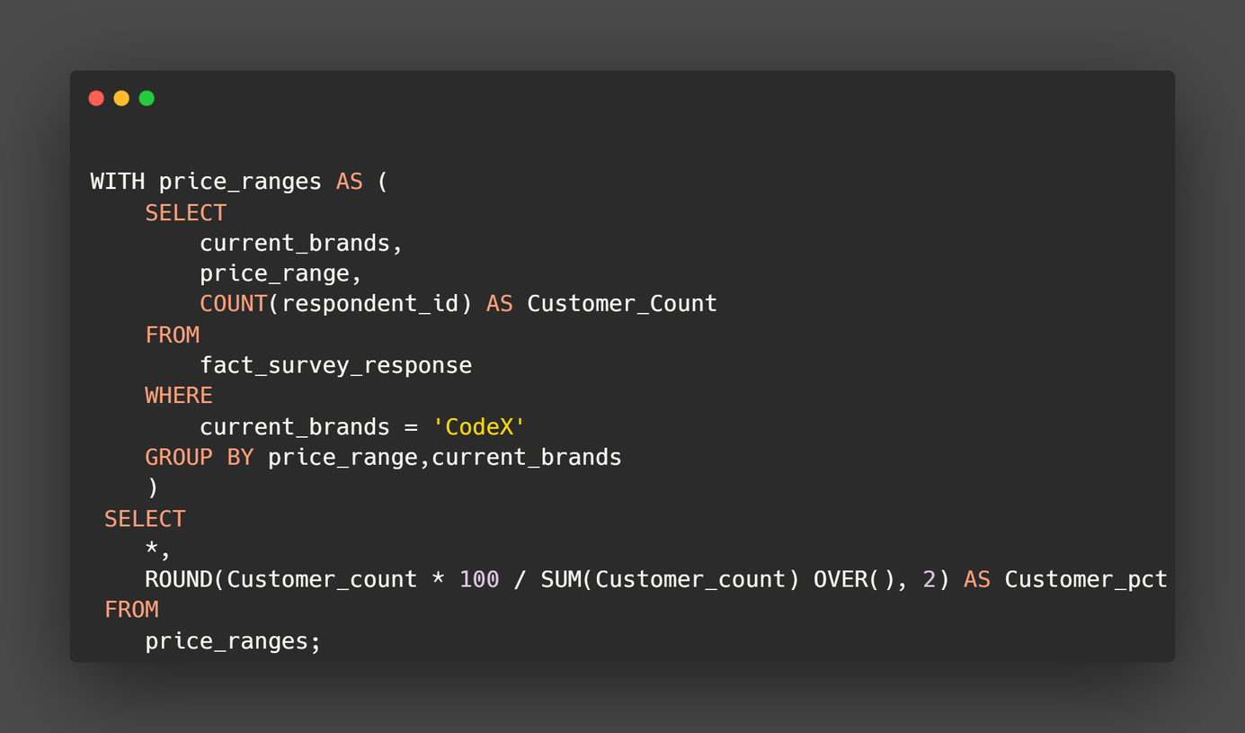
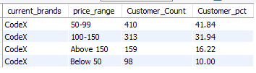
What should be the ideal price of our product?
Below 50
10%
F & B DOMAIN
Above 150
16.2%
50-99
41.8%
34
100-150
31.9%
FUNCTION MARKETING
CodeX should confidently strive to establish a competitive price range between 50 and 99, as this will likely resonate well with the target market and attract a significant number of consumers.

Slide 35
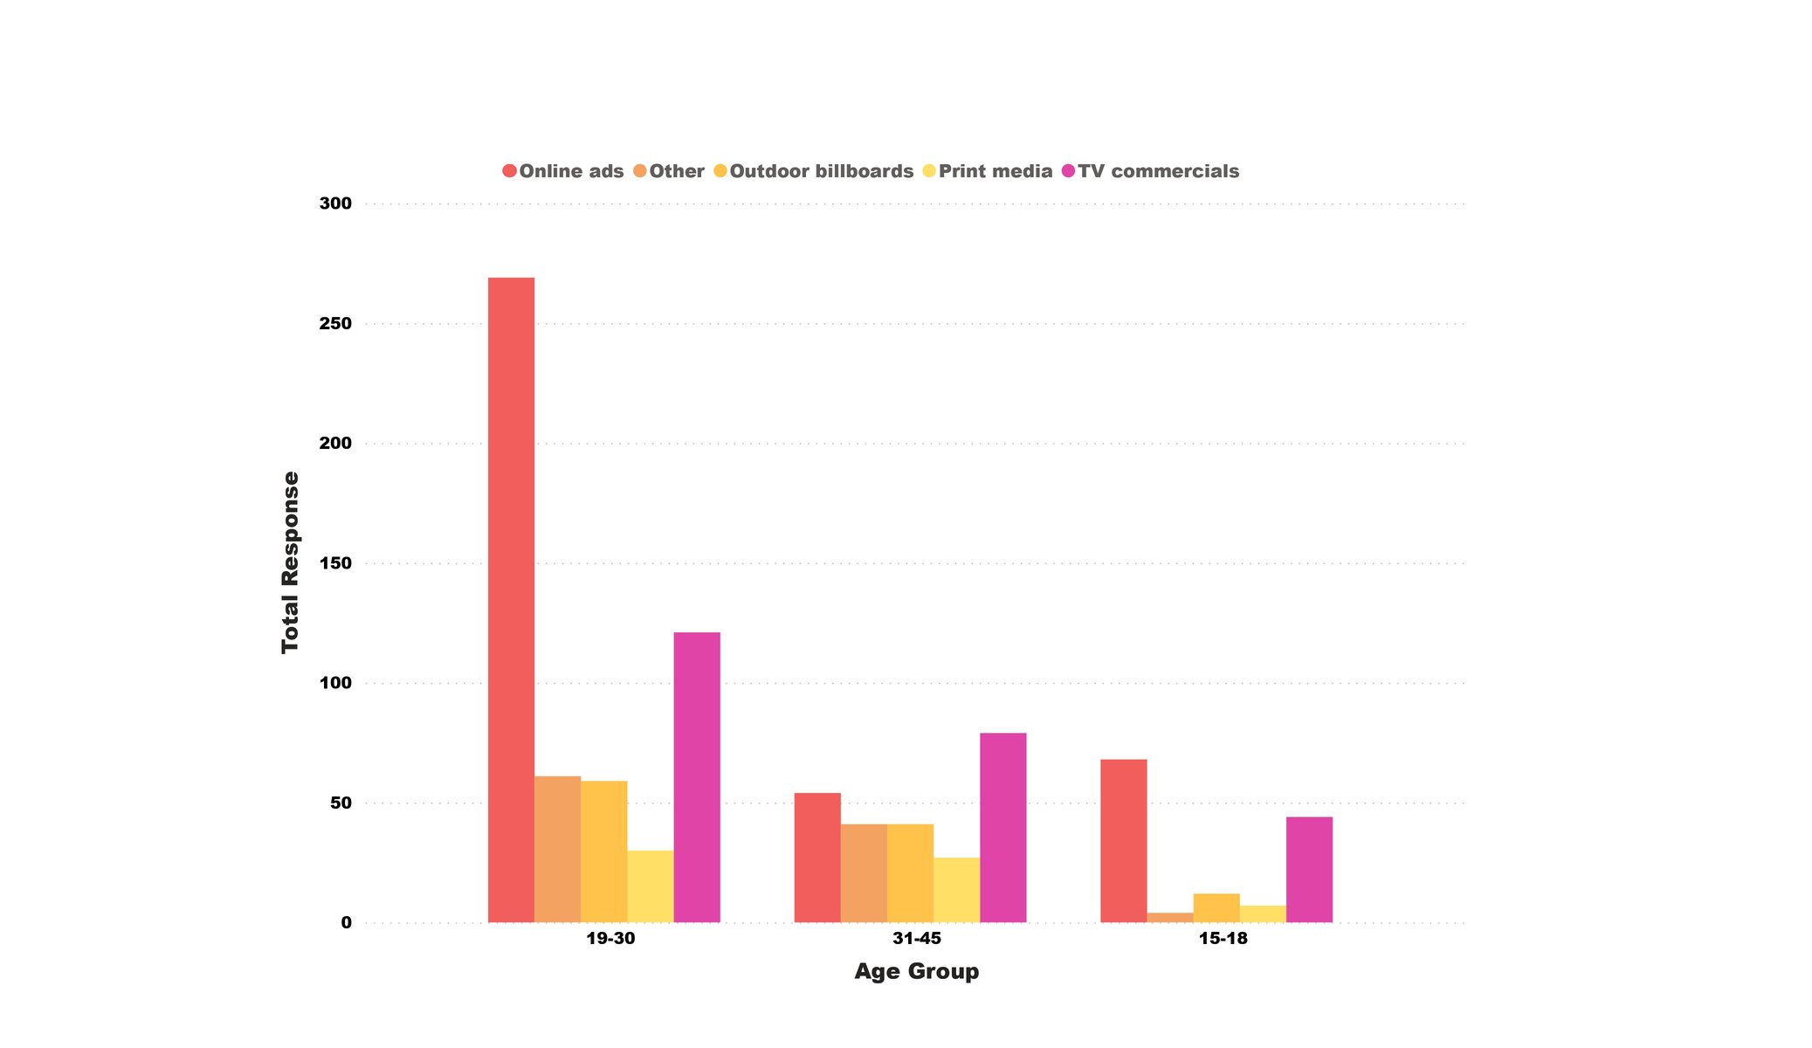

F & B DOMAIN
Who should be our target audience, and why
37
The age group of 15-45 is characterized by a generation that is highly open to trying new products, including energy drinks.
FUNCTION MARKETING

Slide 36

WHAT KIND OF MARKETING CAMPAIGNS, OFFERS, AND DISCOUNTS WE CAN RUN
To effectively reach its major customer base, Codex should consider the following marketing strategies:
Online Channels:
Focus on social media platforms, such as Facebook, Instagram, and Twitter.
Utilize targeted ads and engaging content to connect with the youth demographic aged 15-30.
Explore YouTube ads and collaborations with popular influencers in the energy drink niche.
Advertise on music streaming platforms, leveraging the popularity of music among the target audience.
TV Commercials:
Incorporate TV commercials into the marketing strategy.
Choose channels that cater to viewers aged 31-45, such as news channels, sports channels, and reality TV shows.
Create captivating ads that highlight the unique features and benefits of Codex energy drinks.
Optimize the commercial placements to ensure maximum reach and impact.
Discounts:
Codex should consider running various discounts and offers to attract customers and increase sales of their energy drinks.
Promotional bundles, loyalty programs, limited-time offers, and referral programs can be effective in incentivizing customers to choose Codex.
Targeting specific demographics, such as students, and collaborating with relevant organizations or running social media contests can help create a buzz around the brand and boost customer engagement.
F & B DOMAIN
FUNCTION MARKETING

Slide 37

WHO CAN BE A BRAND AMBASSADOR, AND WHY ?
F & B DOMAIN
Hima Das, a prominent Indian athlete, would be a suitable brand ambassador for an energy drink brand in India due to her athletic achievements, youth appeal, advocacy for health and fitness, national pride, and strong social media presence. Her success, relatability, and ability to inspire the target audience make her an excellent choice to represent the brand and amplify its message.
Athlete
FUNCTION MARKETING
Notes:
Hima Das is a prominent Indian athlete and could be a suitable brand ambassador for an energy drink brand in India. Here are some reasons why she could be a good fit:
1. Athletic Achievements: Hima Das is a highly accomplished athlete and has represented India in various international competitions, including the Olympics.
2. Youth Appeal: Hima Das is a young and dynamic personality, making her relatable and influential among the youth demographic. Her story of overcoming challenges and achieving success can motivate and connect with young consumers who aspire to lead an active and energetic lifestyle.
3. Health and Fitness Advocate: As an athlete, Hima Das prioritizes health and fitness.
4. National Pride: Hima Das is recognized as a national pride due to her accomplishments and contributions to Indian athletics. Her association with an energy drink brand can evoke a sense of patriotism and loyalty among consumers, fostering a positive brand image.

Slide 38
38
F & B DOMAIN
Thank you!
Let us know if you have questions or clarifications.
FUNCTION MARKETING

